Slide 1
For Optimization of photovoltaic power generation
Solar Tracking
By:
Sanjana D 17BCE1068
Maheshvar C 17BCE1172
Chris Kokkat 17BCE1271

Slide 2
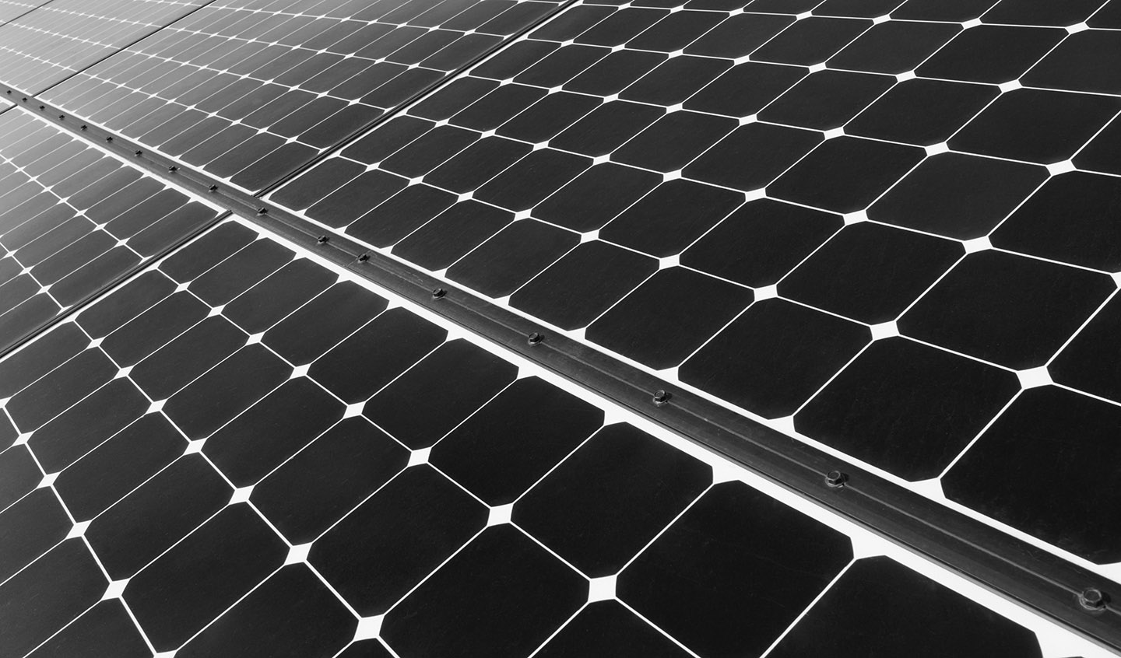
Objective
To obtain a solar panel that is able to obtain its maximum possible power for as long as possible
Enable a solar panel to track the sun and rotate and position itself accordingly such that no part of the solar array is covered by shade due to any obstructing factors
Implement a smart mechanical system to adjust the panel to a better angle and position to re-obtain maximum current and voltage therefore producing maximum power output

Slide 3
Proposed idea
Cloud
Light sensors
Data Backup
Sensor readings
Power Generation and Storage
SOlar Panel
Arduino
Raspberry pi
Servo Motors
Change in angle

Slide 4
Photoresistors
PERCEPTION LAYER
Light dependent resistors, LDRs or photoresistors are often used in circuits where it is necessary to detect the presence or the level of light. They provide a large change in resistance for changes in light level
The LDR gives out an analog voltage when connected to VCC (5V) which varies in magnitude in direct proportion to the input light intensity on it. That is, the greater the intensity of light, the greater the corresponding voltage from the LDR will be

Slide 5
SERVO motors
A servo motor is an electrical device which can push or rotate and object with great precision at specific angles or distance. It is made up of simple motors which run through servo mechanism.
It is possible to obtain very high torque servo motors in small lightweight packages.
The position of a servo motor is decided by electrical pulse. It works on PWM (Pulse width modulation) principle, meaning its angle of rotation is controlled
The electrical pulse from the Arduino controls the servos and determines through which angle it is to be rotated.

Slide 6
Arduino UNO
FOG LAYER
The Arduino Uno is an open-source micro controller board based on the Microchip ATmega328P micro controller. The board is equipped with sets of digital and analog input/output (I/O) pins that may be interfaced to various expansion boards (shields) and other circuits.
We use the Arduino to take in readings from our LDRs and send command signals to the servo motors to control the positioning of the solar panel.
The Arduino is interfaced with a Raspberry Pi using the python API, Pyserial module, which encapsulates the access for the serial port . Data is then serially communicated across the physical ports.
Depending on the computation and signals received from the Pi, the Arduino controls the angle of the servos such that it faces the sun to receive maximum amount of sunlight.

Slide 7
Raspberry pi
Fog layer
The Raspberry Pi is a series of small single-board computers. It uses the a Broadcom BCM2835 SoC running at 1 GHz CPU clock speed. It has 512 MB of RAM. The Raspberry Pi Zero W is of a smaller size and reduced I/O and general purpose input/output (GPIO) capabilities with wifi and bluetooth capabilities.
On the Pi Zero, the USB port is connected directly to the SoC, but it uses a micro USB (OTG) port.
The bytes sent by the Arduino are converted to string and perceived by the Pi.
A python script is run upon starting to collect data from the Arduino and run a machine learning model using the Sklearn package.
A simple polynomial regression is fit to the data and the entire computation is done locally on the Pi. The model is thereafter run according to which the motion of the panel is determined.

Slide 8
GOOGLE Cloud
CLOUD LAYER
Data transmitted from the sensors to the Raspberry Pi is pushed to the cloud at regular intervals and stored in Google’s Firebase for storage and data backup.
In case of a device failure, the data can be retrieved from the cloud and the model can be retrained to re-achieve proper functionality.
On expansion, larger amounts of data can be stored and the project has a larger scope for scalability

Slide 9
Algorithm
The sensor values of each corner are read and the average value of all four sides of the panel are calculated. The panel is adjusted such that the averages equalise
Once a stable position is reached and a certain number of values are obtained a model is trained according to which the panel will continue to optimise its positioning to obtain maximum sunlight
If the power being generated unusually drops below the regular levels then the sensors start sensing again and the data collected is used to retrain the model for reconfiguration purposes

Slide 10
Hardware
Text

Slide 11
Software
Text

Slide 12
T
h
A
Y
N
O
K
U

